Slide 1


RADAR EQUIPMENT
HEALTH MONITORING
SYSTEM
Monitoring temperature, vibration and smoke inside an equipment enclosure using an ESP32 and MicroPython
College: KALASALINGAM UNIVERSITY
Department: ELECTRONICS AND COMMUNICATION ENGINEERING
Team members:
DHARANEESWARAN M 9925005044
KODIESWARAN R 9925005083
AAKASH M 9925005084
SAKTHI MURUGAN MANOJKUMAR VIMALA 9925005134
TEAM 07
QUANTUM FORGE
GitHub link : https://github.com/Dharaneesh2826/Smart-Radar-Equipment-Health-Monitoring

Slide 2
INTRODUCTION
Radar equipment sits inside closed enclosures and cabinets, so a developing problem is hard to spot from outside. Manual checks happen only now and then, and a fault can grow in between.
Our basic idea
1
Sense
DHT22, MPU6050 and MQ2 measure temperature, humidity, vibration and smoke.
Temperature
Vibration
Smoke
Blocked vents or a failed fan let heat build up. Long exposure shortens component life.
Loose mounts or a worn fan change the vibration pattern before something breaks.
A late but serious sign of overheating or burning insulation. It needs action at once.
2
Decide
ESP32 compares the readings with limits and sets the state: NORMAL, DEGRADED or CRITICAL.
3
Alert
Heat, vibration and smoke are three different early signs of trouble, so we monitor all three together in one small unit.
LEDs and buzzer warn at the equipment. The data also goes to a Flask dashboard over Wi-Fi.

Slide 3
PROBLEM STATEMENT
Unnoticed condition | What can go wrong
Abnormal temperature | Overheating, unstable operation, shorter component life and unexpected shutdown
Abnormal vibration | Loose connectors and mounts, cracked solder joints, wear on moving parts such as fans
Smoke | Burning insulation or components, damage to the whole cabinet and fire risk
What we need
Continuous monitoring, not only periodic checks
Early warning before damage happens
Local alerts that work even without the network
A record of what happened and when
Without monitoring
Fault starts
Nobody notices
Damage or downtime
With monitoring
Fault starts
Sensors detect it
Operator alerted early

Slide 4
PROJECT OBJECTIVES
1
2
3
Monitor temperature and humidity
Detect abnormal vibration
Identify smoke conditions
DHT22 gives continuous readings from inside the enclosure.
MPU6050 readings are turned into a vibration RMS value.
MQ2 gives a rough indication of smoke.
4
5
6
Generate local alerts
Show readings on a web dashboard
Keep monitoring when Wi-Fi drops
red and green LEDs and a buzzer show the state at the equipment.
A Flask dashboard on a laptop shows live values, graphs and an event log.
The ESP32 keeps reading sensors and raising local alerts without the network.

Slide 5
EXISTING SYSTEM AND PROPOSED SYSTEM
Feature | Existing: manual monitoring | Proposed: our prototype
Checking | Operator inspects now and then | Sensors read continuously
Temperature | Touch or a handheld thermometer when someone remembers | DHT22 reading compared with 40°C and 60°C limits
Vibration | Noticed only when it is strong enough to feel or hear | MPU6050 vibration RMS compared with 0.10 g and 0.50 g
Smoke | Smell or sight, usually late | MQ2 smoke detection triggers the CRITICAL state
Alert | None until a person notices | LEDs and buzzer respond straight away
Records | Handwritten log or nothing | Timestamped event log, CSV export and a live dashboard
Limitation of manual checks: they depend on someone being there at the right time.
What we improve: always-on sensing, instant local alerts and a record of events.

Slide 6
SYSTEM ARCHITECTURE
DHT22
Temperature and humidity
ESP32
MicroPython
Read the sensors
Calculate vibration RMS
Compare with thresholds
Decide NORMAL, DEGRADED or CRITICAL
LEDs and buzzer
Send data over Wi-Fi
Local alert outputs
GPIO 4
digital data
Buzzer
GPIO 25
GPIO / I2C
MPU6050
Vibration (accelerometer)
Green LED
GPIO 26
Red LED
GPIO 27
I2C
SDA 21, SCL 22
MQ2
Smoke (analog output)
GPIO 34
Laptop: WEB dashboard through Telegram
Wi-Fi
ADC, via divider
Live readings and graphs
Event log with timestamps
Editable thresholds
CSV export
sensor data
If Wi-Fi disconnects, the ESP32 still reads the sensors and drives the OLED, LEDs and buzzer locally.

Slide 7
COMPONENT SPECIFICATIONS AND PIN CONNECTIONS
Component | Signal | ESP32 pin | Power | Purpose
DHT22 | Data | GPIO 4 | 3.3V | Temperature and humidity
MQ2 | Analog output | GPIO 34 through a 10kΩ + 20kΩ voltage divider | 5V | Smoke level
MPU6050 | SDA / SCL | GPIO 21 / GPIO 22 | 3.3V | Vibration (I2C)
Buzzer | Signal | GPIO 25 | – | Audio alert
Green LED | Signal | GPIO 26 with 220Ω resistor | – | Normal indication
Red LED | Signal | GPIO 27 with 220Ω resistor | – | Warning indication
Power: DHT22, MPU6050 and OLED run on 3.3V. MQ2 needs 5V, so its analog output is stepped down by the 10kΩ + 20kΩ divider before it reaches the ESP32 ADC pin.

Slide 8
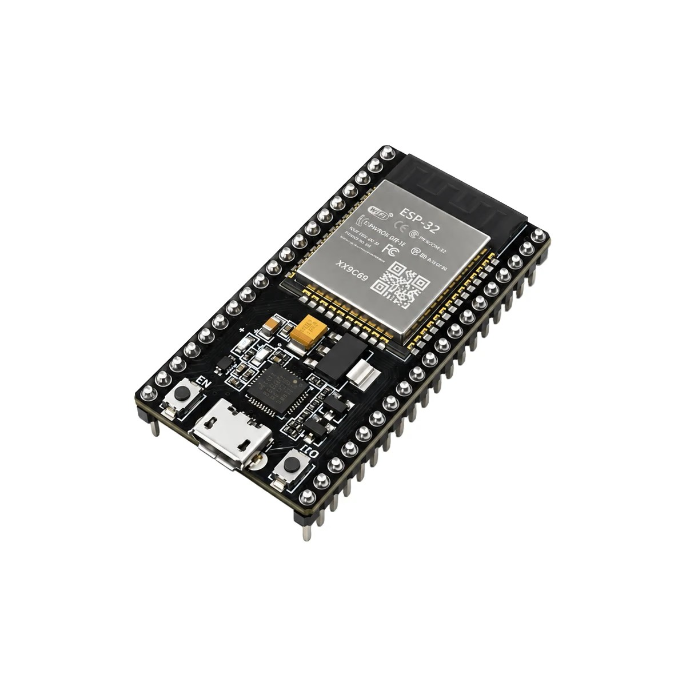
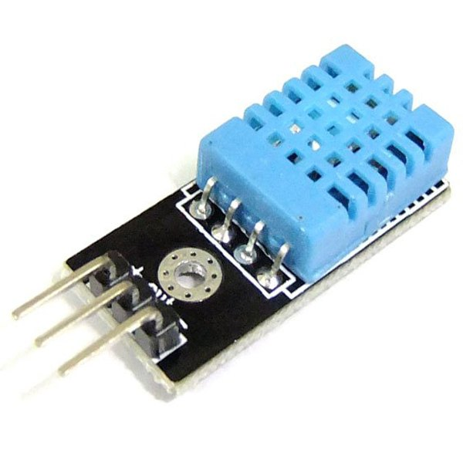
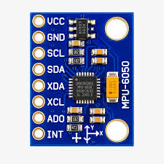
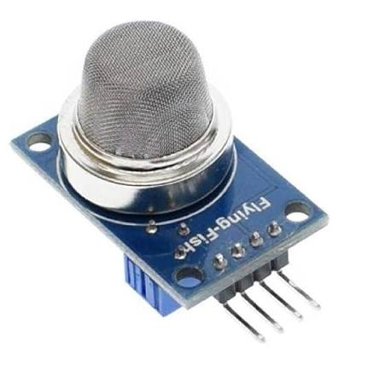
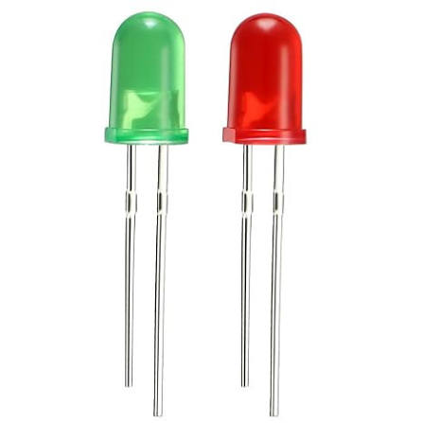
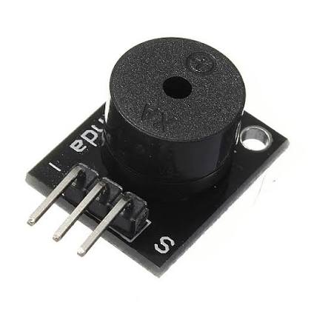
HARDWARE COMPONENTS
ESP32
DHT22
2
Add component photo
Add component photo
ESP32
DHT22
MPU6050
MQ2
Function: Main controller with built-in Wi-Fi.
Why: Reads sensors, decides the state, drives outputs and sends data.
Function: Temperature and humidity sensor.
Why: Shows heat build-up inside the enclosure.
Function: Accelerometer and gyroscope over I2C.
Why: We calculate vibration RMS from its readings.
Function: Smoke and gas sensor with analog output.
Why: Gives a rough smoke indication for the CRITICAL state.
Red and green LEDs
Buzzer
Function: Simple status indicators.
Why: Green means NORMAL, red means a warning. Visible from a distance.
Function: Audio alert.
Why: Sounds in DEGRADED and gives a fast siren in CRITICAL.

Slide 9
WORKING PRINCIPLE
1
2
3
4
5
6
Sensors collect readings
ESP32 processes the readings
Vibration RMS and thresholds are evaluated
System identifies the operating condition
Buzzer activates when required
Data is sent to the Flask dashboard over Wi-Fi
Program flow (repeats continuously)
NORMAL
all readings within limits
Check against thresholds
Read DHT22, MPU6050 and MQ2
Calculate vibration RMS
DEGRADED
temp ≥ 40°C or vibration ≥ 0.10 g
Update OLED, LEDs and buzzer
CRITICAL
smoke, temp ≥ 60°C or vibration ≥ 0.50 g
Send data to Flask dashboard over Wi-Fi

Slide 10
HEALTH MONITORING AND ALERT LOGIC
State | Condition | Local response
NORMAL | Temperature below 40°C, vibration below 0.10 g and no smoke detected | Green LED ON, buzzer OFF
DEGRADED | Temperature ≥ 40°C OR vibration ≥ 0.10 g | Red LED and buzzer ON
CRITICAL | Smoke detected OR temperature ≥ 60°C OR vibration ≥ 0.50 g | Fast siren, red LED and OLED flashing
Zones (drawn for explanation, not to scale)
Temperature
NORMAL below 40°C
DEGRADED 40 to 60°C
CRITICAL 60°C and above
Vibration
NORMAL below 0.10 g
DEGRADED 0.10 to 0.50 g
CRITICAL 0.50 g or more
Smoke
NORMAL no smoke detected
CRITICAL smoke detected

Slide 11
SOFTWARE IMPLEMENTATION
MicroPython: the whole program on the ESP32 is written in MicroPython.
Data acquisition: read DHT22, MQ2 (ADC) and MPU6050 (I2C).
Threshold comparison: compare each reading with its limit to find the state.
Vibration RMS: calculate an RMS value from the MPU6050 readings.
LED and buzzer control: GPIO outputs change with each state.
Wi-Fi communication: send sensor data from the ESP32 to the laptop.
WEB dashboard: runs on the laptop and shows the incoming data.

Slide 12
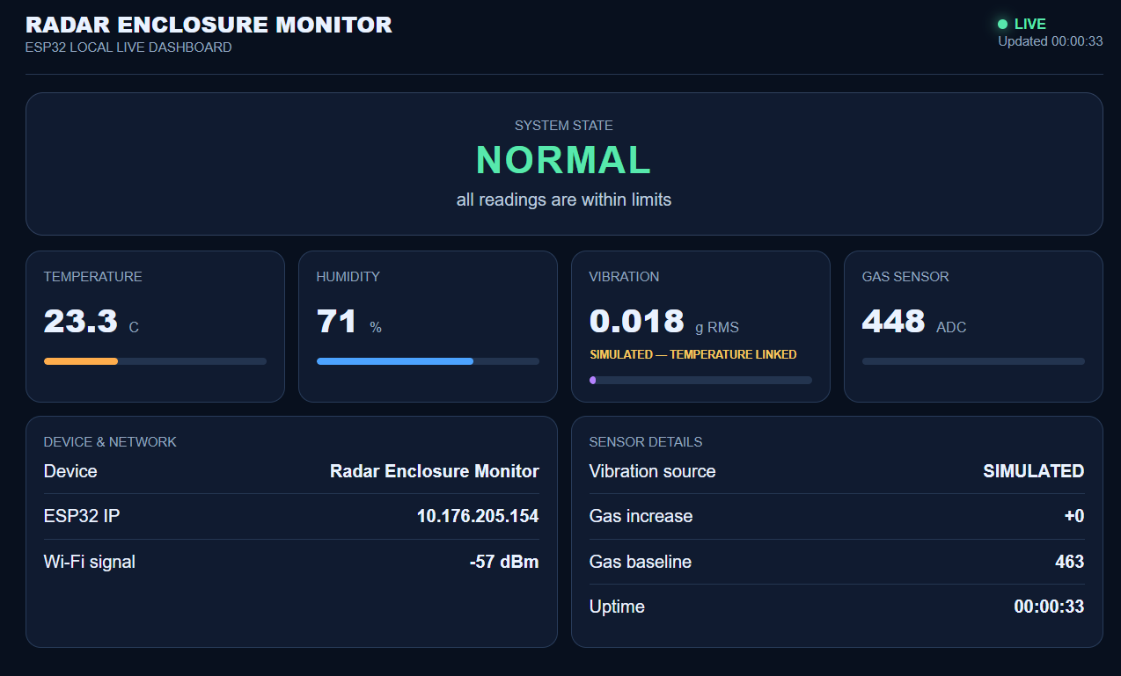
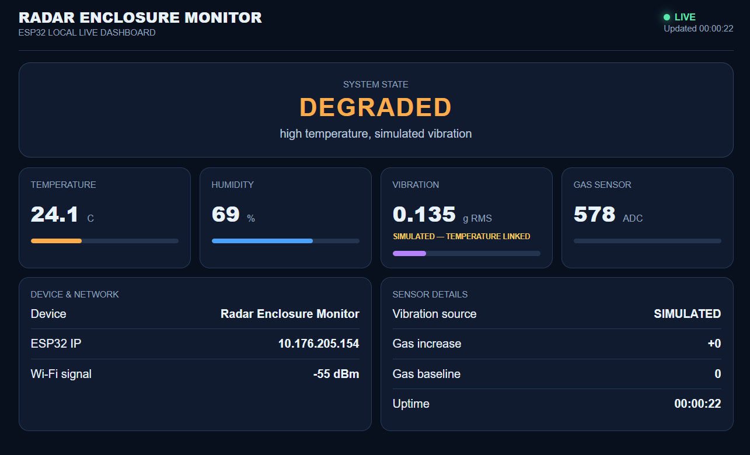
WEB DASHBOARD
What each part does
Live readings: temperature, humidity, vibration RMS and smoke status
System state: NORMAL, DEGRADED or CRITICAL
Graphs: sensor values plotted over time
Event log: timestamped state changes and alerts
Threshold settings: editable limits for temperature and vibration
TELEGRAM BASED LINK SHARING OF THE DASHBOARD ALONG WITH THE REAL TIME VALUES OF THE RADAR ENVIRONMENT ELEMENTS FOR EVERY 30 SECONDS
Mock-up of the dashboard layout. The values shown are placeholders, not measured data.

Slide 13
TESTING AND DEMONSTRATION
1
Start with the normal condition: green LED ON, buzzer OFF.
Condition | Expected response
Normal operation | NORMAL: green LED ON, buzzer OFF
DHT22 warmed (temperature ≥ 40°C) | DEGRADED: red LED and buzzer ON
Enclosure tapped (vibration ≥ 0.10 g) | DEGRADED: red LED and buzzer ON
Smoke present (supervised only) | CRITICAL: fast siren, red LED
Readings back to normal | Alerts clear automatically, green LED ON
Wi-Fi disconnected | LEDs and buzzer still work locally
2
Warm the DHT22 gently to show the temperature warning.
3
Tap the enclosure gently to show the vibration change.
4
Smoke demonstration only if permitted, safe, controlled and supervised.
5
Show the critical alert.
6
Let the system return to normal and show the alerts clearing by themselves.

Slide 14
ADVANTAGES AND APPLICATIONS
Advantages
Applications
Continuous monitoring
Early warning
Industrial equipment enclosures
Readings are taken all the time, not only at inspection.
The alert comes while the fault is still small.
Electronic control cabinets
Local alert system
Remote dashboard
LEDs and buzzer work at the equipment itself.
The operator can watch from a laptop over Wi-Fi.
Laboratory equipment
Low-cost prototype
Data logging
Built from common, inexpensive modules.
Timestamped events and CSV export.
Equipment monitoring prototypes

Slide 15
LIMITATIONS AND FUTURE SCOPE
Limitations
Future Scope
Prototype thresholds
SMS / email notifications
alert the operator even when away from the laptop
The limits are demonstration values, not certified industrial limits.
Database integration
keep long-term logs instead of only CSV files
Relative vibration value
MPU6050 is a hobby-grade sensor, so vibration RMS is only a relative measure.
Predictive maintenance
use trends in the sensor data to spot problems earlier
Rough smoke indication
Multi-cabinet monitoring
one dashboard for several enclosures
MQ2 shows that smoke is likely, not an exact ppm value.

Slide 16
CONCLUSION
Thank You
Our prototype monitors temperature, humidity, vibration and smoke inside an equipment enclosure.
The ESP32 sorts the condition into NORMAL, DEGRADED or CRITICAL using adjustable thresholds.
LEDs and buzzer warn the operator at the equipment, even when Wi-Fi is down.
The Flask dashboard adds live readings, graphs, an event log and CSV export.
Together this helps the operator notice abnormal conditions early, before they turn into damage.
Questions?
Hackathon – Team 07

